Slide 1
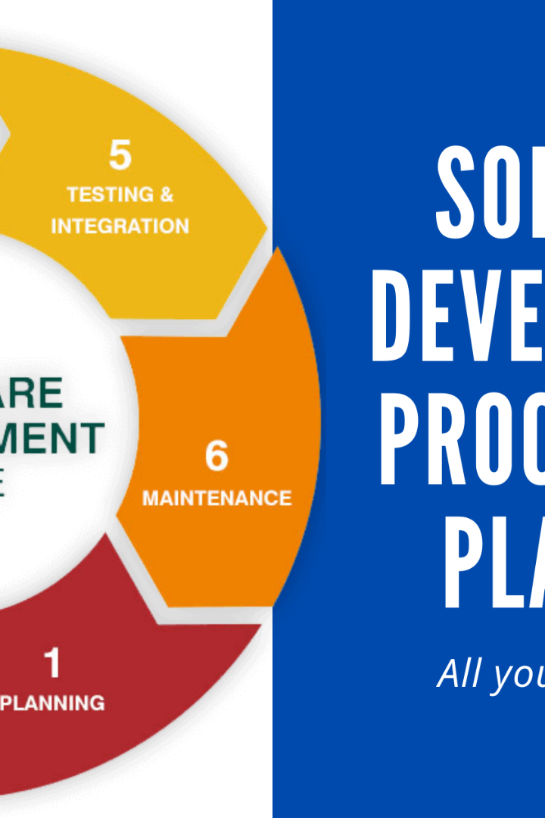
FOUNDATION BOOTCAMP JOURNEY

Slide 2
Corporate Learnings : Soft Skills
1
Confidence is Key
2
Effective Communication
3
Accept Constructive Criticism
Be confident in yourself and your abilities, it's the first step to success in the corporate world.
Speak clearly and loud enough to be heard. Always think before you talk and use expression to emphasize your point.
Continuous improvement is necessary for growth. Take constructive criticism as an opportunity to refine your skills and keep raising the bar.
4
Perseverance is Everything
5
Patience Pays Off
Always have a positive attitude and believe in yourself. Say to yourself, "I can, I will, I must!" Persistence will lead you to reach your goals.
Don't find shortcuts or hesitate to ask for help. Professionalism requires patience, perseverance and persistence and will ultimately lead you to succeed in the corporate world.

Slide 3
The 4 Ps
Practice
Praise
Success comes with hard work and a willingness to fail before achieving success. Don't expect immediate results without putting in effort.
Take constructive criticism and use it as an opportunity to improve. Always raise the bar for yourself and your work.
Persistence
Patience
Believe in yourself and be passionate. Don't give up easily, say to yourself "I can, I will, I must."
Don't look for shortcuts and don't hesitate to ask for help when needed. Stay patient and calm.

Slide 4
Professionalism at the Workplace
Collaboration is Key
Work harmoniously with your team, stay punctual and prepared. Listen carefully to the opinions of others, and respect their insights. Plan ahead and set boundaries to stay focused and productive.
1
2
The Five R Technique
Remember the five Rs: Right Information, Right Person, Right Time, Right Place, and Right Technology. Following this technique, you can ensure clear and effective communication.

Slide 5

Software Development Life Cycle
Understand the different phases of the Software Development Life Cycle to develop high-quality software. From requirement analysis to software testing, every stage is crucial and requires meticulous attention to detail.

Slide 6
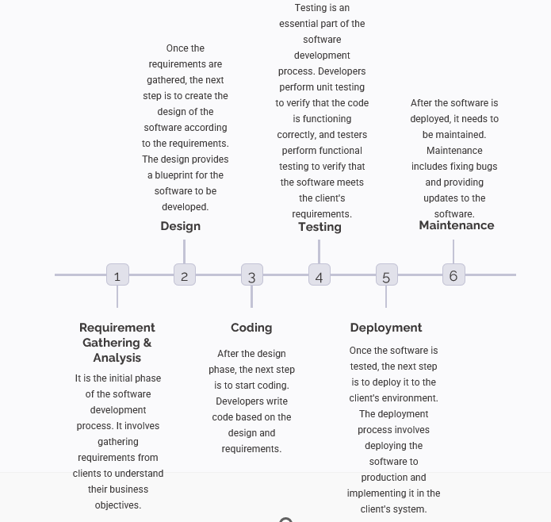
Software Development Life Cycle

Slide 7
Software Testing Life Cycle
1
Requirement Analysis
Understand the client's requirements and create a detailed plan for software creation and testing.
2
Test Planning & Test Case Development
Develop comprehensive test cases and create test plans accordingly. Consider both positive and negative testing scenarios for the best possible outcomes.
3
Environment Setup
Ensure a set-up that allows efficient testing, including both software and hardware specifications.
4
Test Execution & Test Case Closure
Test the software in the designed environment to ensure it passes all test cases. Close test cases once the software has been deemed suitable for deployment.
5
Acceptance Testing
Also known as Green Box Testing, this final testing phase ensures the software is fully reliable and functional for the client in a live production environment.

Slide 8
Testing Techniques
White Box Testing
Black Box Testing
This technique is used by developers who understand the internal architecture of the software. It involves the development of unit tests and requires rigorous testing to ensure maximum quality.
This technique does not involve knowledge of the internal architecture of the software. It is performed by QA engineers and is focused on integration testing, ensuring the software works seamlessly with all components.
Grey Box Testing
Boundary Value Analysis
Automation engineers perform this technique relying on QA engineers to provide testing scenarios based on their knowledge of the internal architecture of the software.
This involves checking for the edge cases of the program to ensure that the software works even under less than ideal conditions.

Slide 9
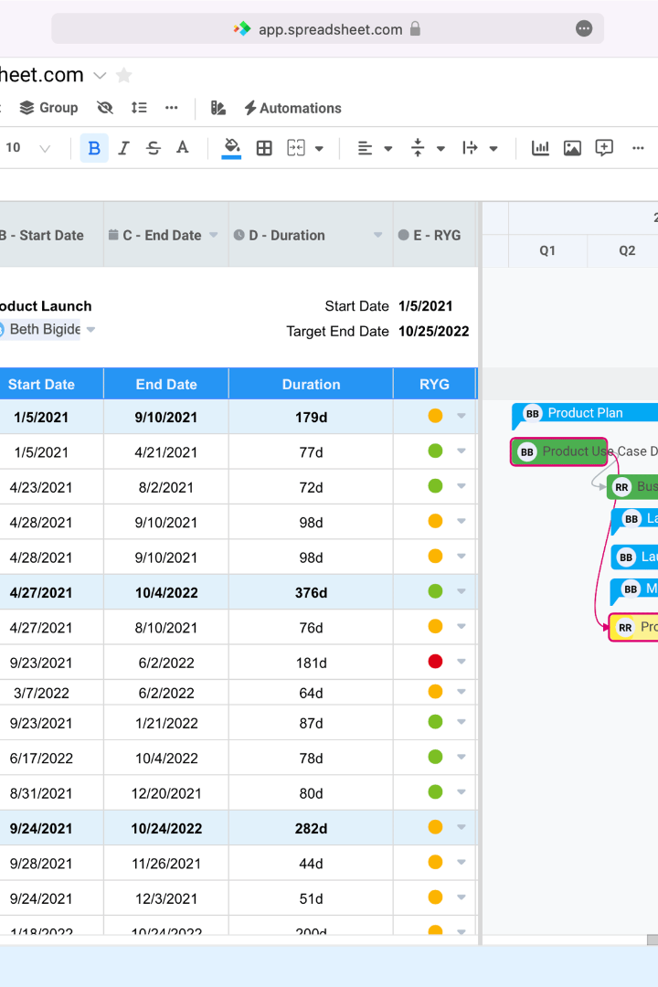
Gantt Chart
Gantt charts are an essential tool in project management. They help in planning, coordinating, and tracking specific tasks. The chart consists of a bar graph that displays the project's schedule. Each bar represents a specific task, and the length of the bar represents the time needed to complete that task.

Slide 10
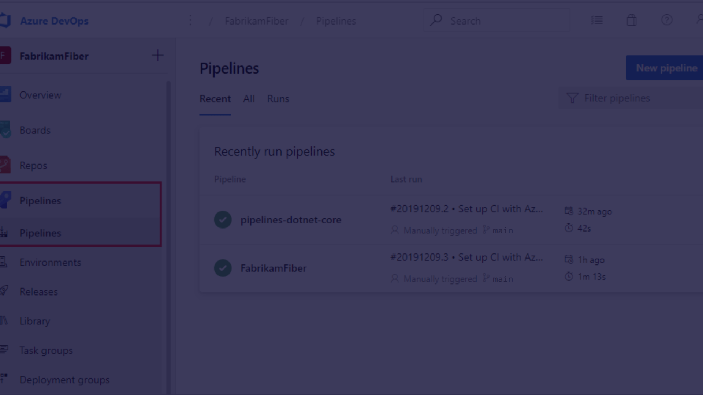
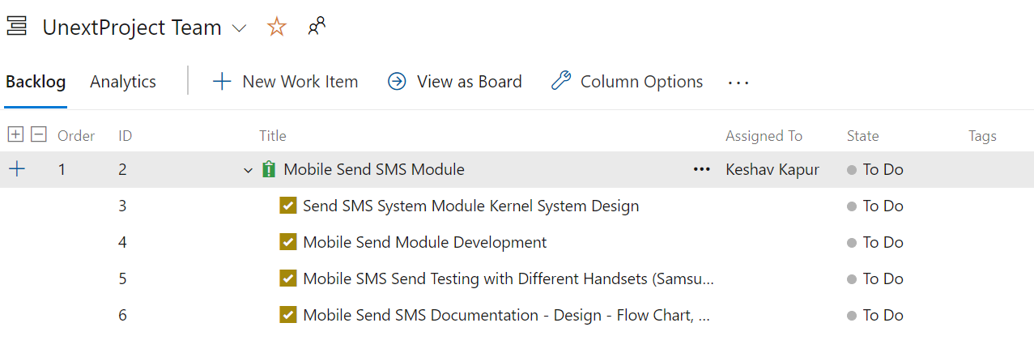
Azure DevOps
Azure DevOps is a platform used to build and test software projects. It facilitates the entire process of software creation, from managing code to testing and deploying it on multiple platforms.

Slide 11

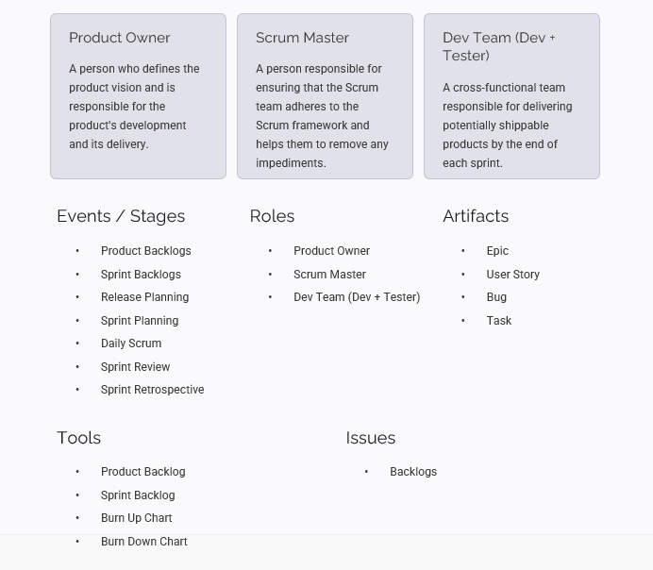
SCRUM OVERVIEW

Slide 12
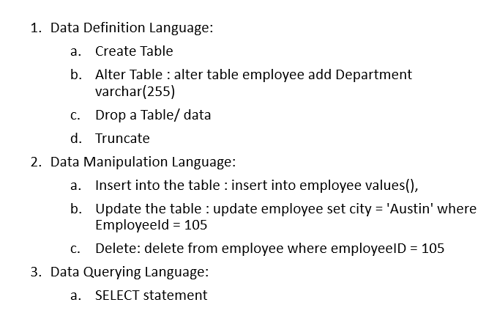
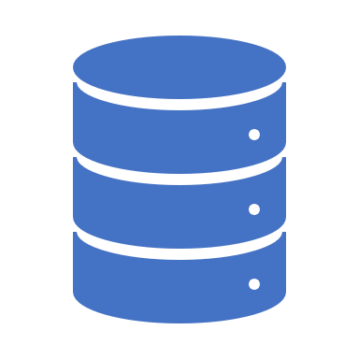
DATABASE MANAGEMENT SYSTEM

Slide 13
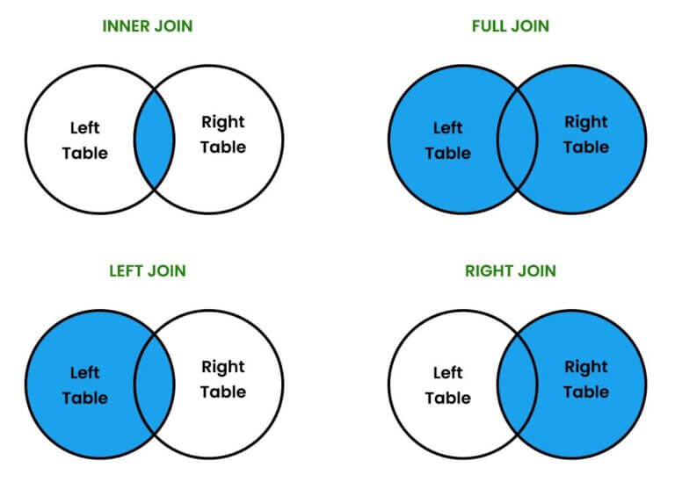
TYPES OF JOINS
A join clause in the Structured Query Language combines columns from one or more tables into a new table.

Slide 14
TESTING BASICS
Why do we Test?
To maintain quality.
Documentation to maintain standards of software
The First Document we get is Test Strategy Document
What do Testers have to do when Developers are working on the application?
Write Manual test cases
Create Test Environment
What is Manual Testing?
Testing done by humans by manually executing tests.
Two types of testing:
Functional Testing
Functions of the Application are checked
Non-Functional Testing
Graphical User Interface
Alignment
Spelling

Slide 15
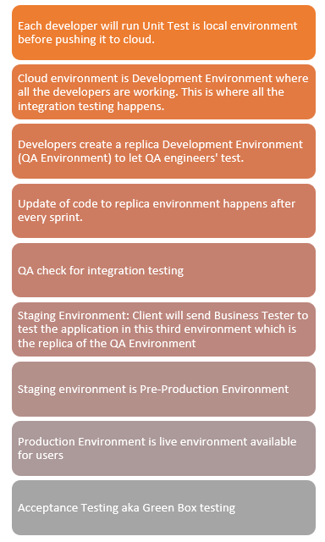
TESTING HIERARCHY

Slide 16
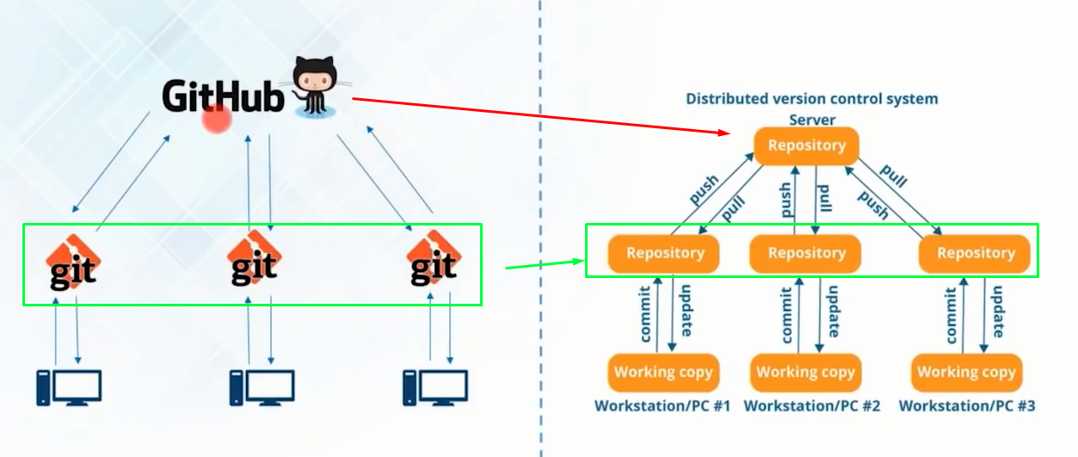
GIT AND GITHUB ACTIONS
GitHub is a platform and cloud-based service for software development and version control using Git, allowing developers to store and manage their code. It provides the distributed version control of Git plus access control, bug tracking, software feature requests, task management, continuous integration,

Slide 17

DOCKERHUB AND DOCKERFILE
Docker Hub is a repository service and it is a cloud-based service where people push their Docker Container Images and also pull the Docker Container Images from the Docker Hub anytime or anywhere via the internet. It provides features such as you can push your images as private or public.
A Dockerfile is basically a shell script that tells Docker how to build your image.

Slide 18
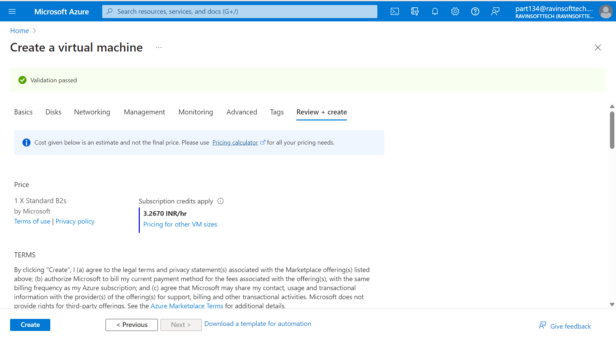
CREATE A VM ON AZURE

Slide 19
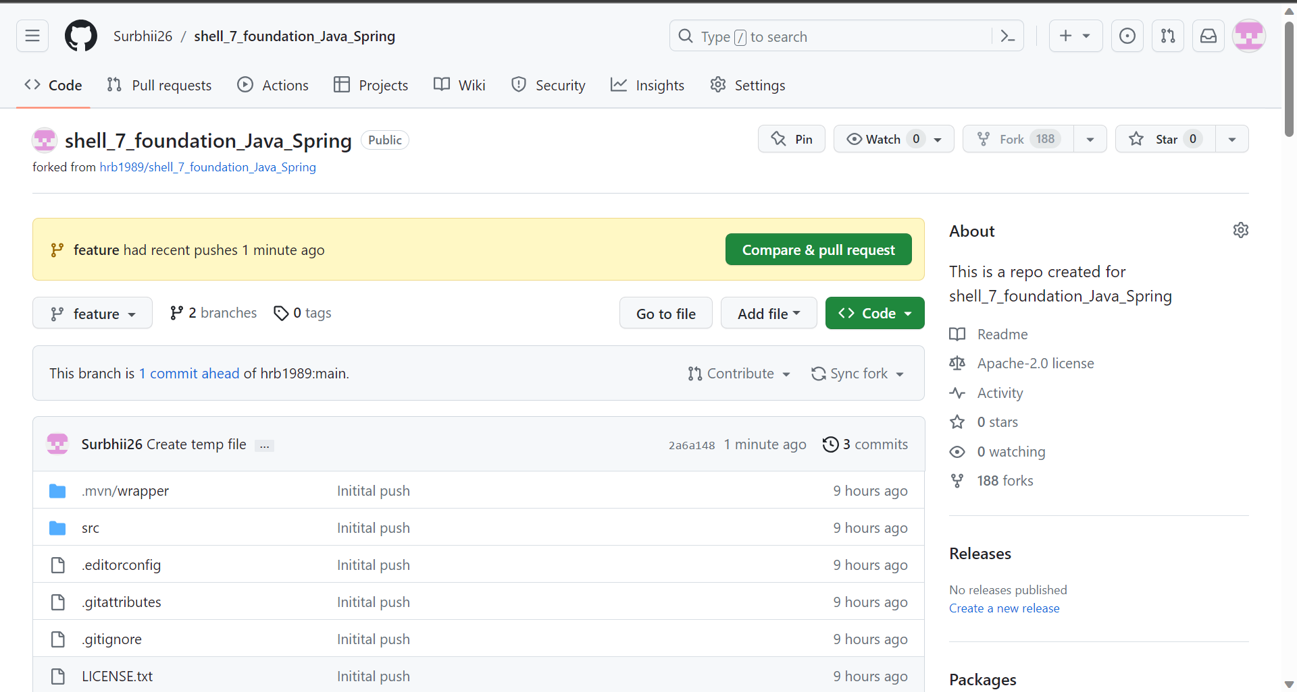
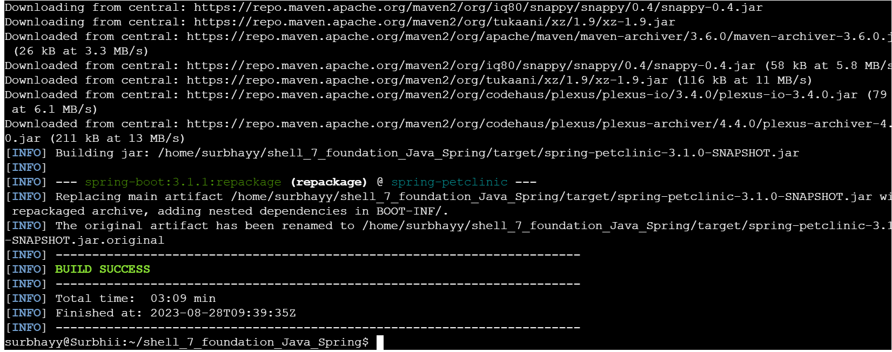
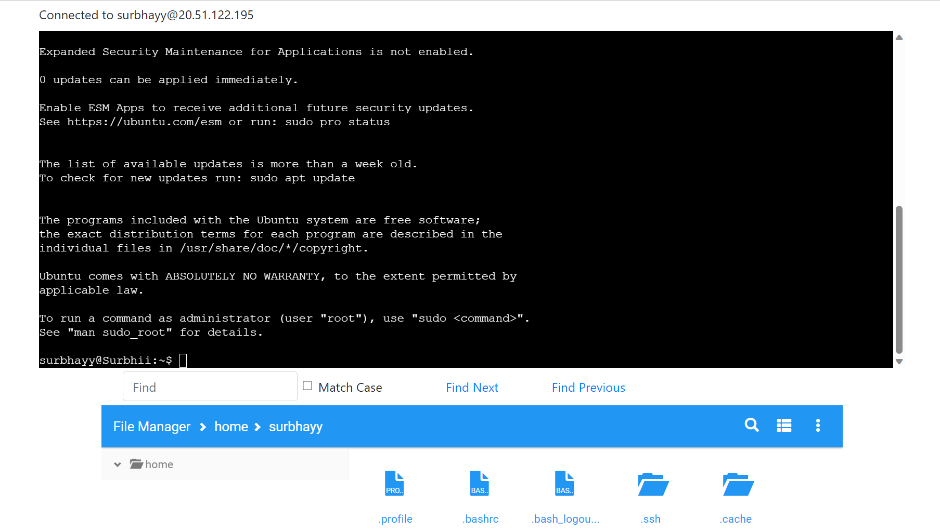
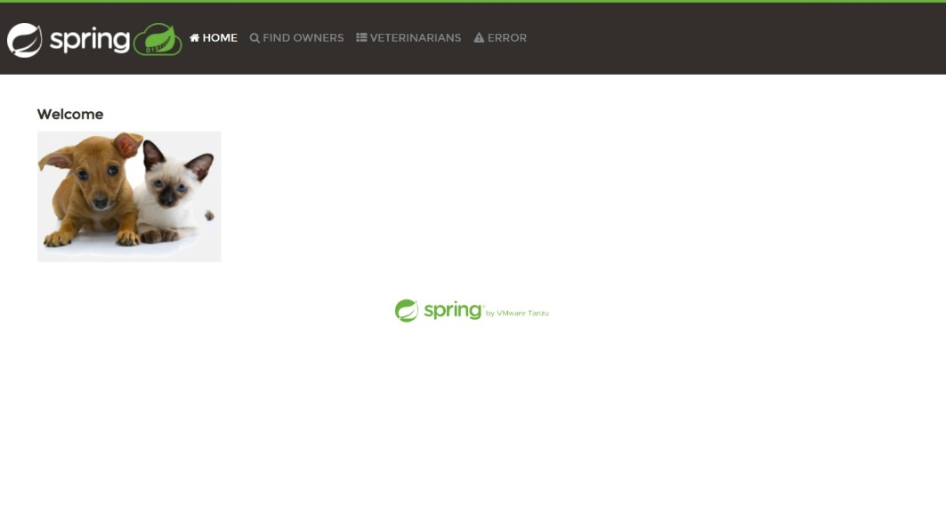
FINAL ASESSMENT

Slide 20

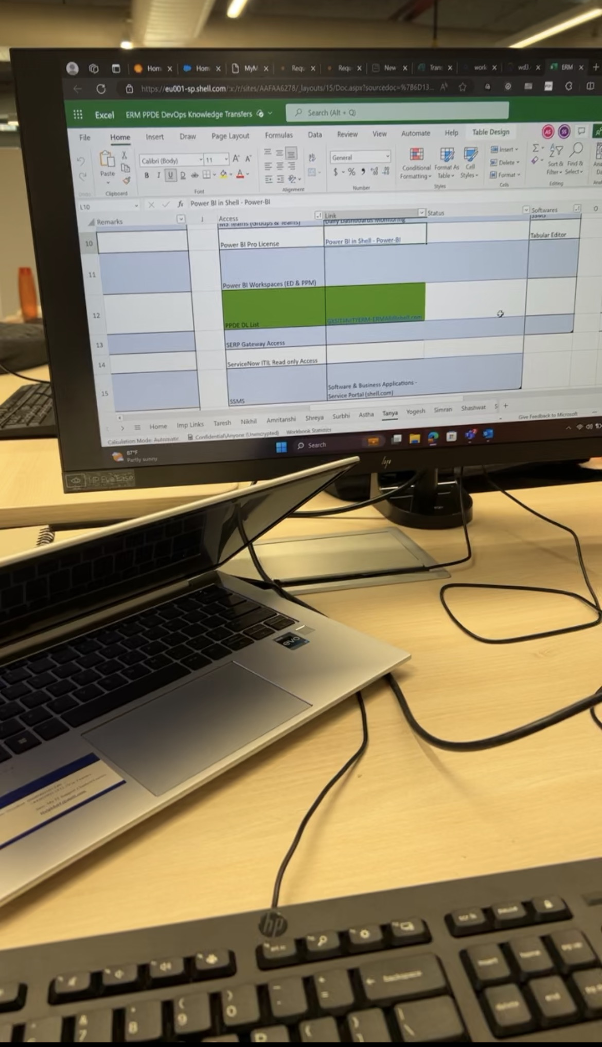
STEP INTO REAL CORPORATE WORLD
I went to Xenon office, met my team , had several meetings along with them. It was a great experience. I set up few applications important to shell for basic functioning. It was a tough day for my team which means great learnings on the very first day for me.

Slide 21
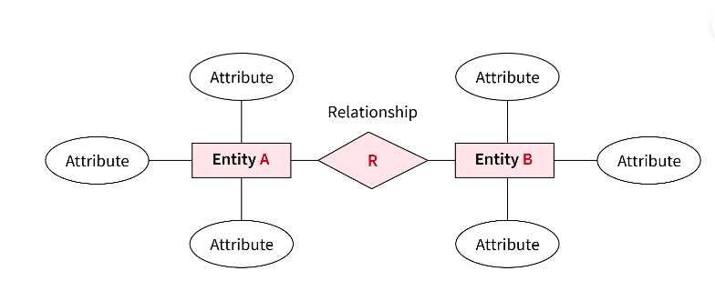
ERM MODEL
ER model in DBMS is the high-level data model. It stands for the Entity-relationship model and is used to represent a logical view of the system from a data perspective.
It develops a conceptual design for a database that provides a very simple and straightforward view of the data. ER model makes use of ER diagrams, which are the diagrams sketched to design a database.
ER diagrams are built on three basic concepts: entities, attributes, and relationships between them. An ER diagram in DBMS defines entities, associated attributes, and relationships between entities. This helps visualize the logical structure of the database.

Slide 22
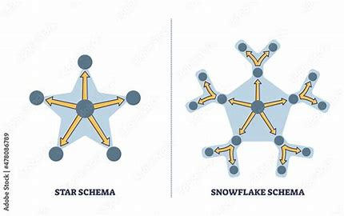
SCHEMAS

Slide 23
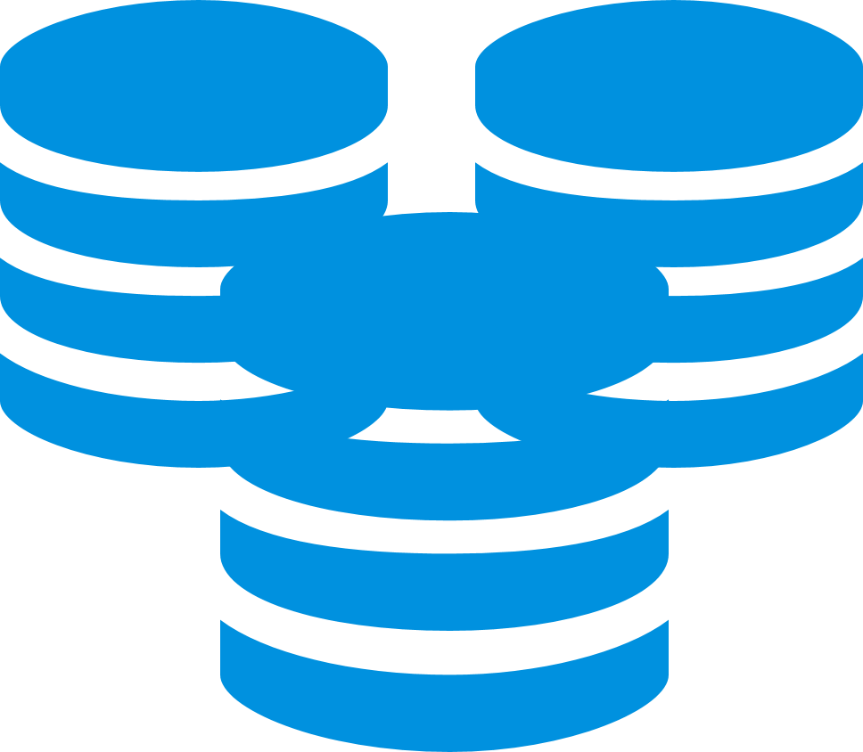
WHAT IS BIGDATA?
Big data primarily refers to data sets that are too large or complex to be dealt with by traditional data-processing application software. Data with many entries (rows) offer greater statistical power, while data with higher complexity (more attributes or columns) may lead to a higher false discovery rate . Though used sometimes loosely partly due to a lack of formal definition, the best interpretation is that it is a large body of information that cannot be comprehended when used in small amounts only.
Big data analysis challenges include capturing data, data storage, data analysis, search, sharing, transfer, visualization, querying, updating, information privacy, and data source. Big data was originally associated with three key concepts: volume, variety, and velocity.

Slide 24
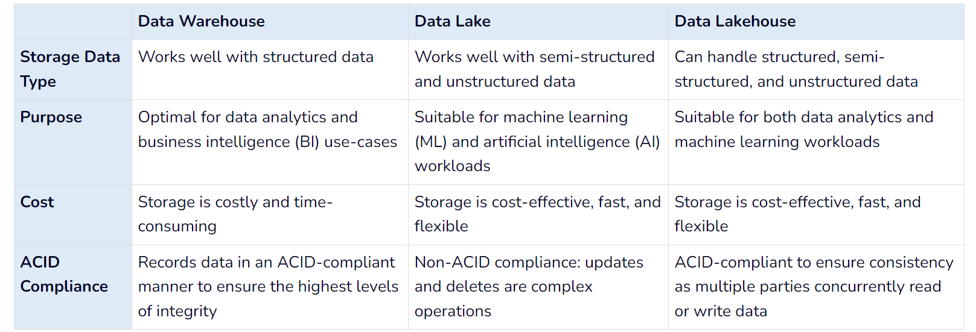

Slide 25
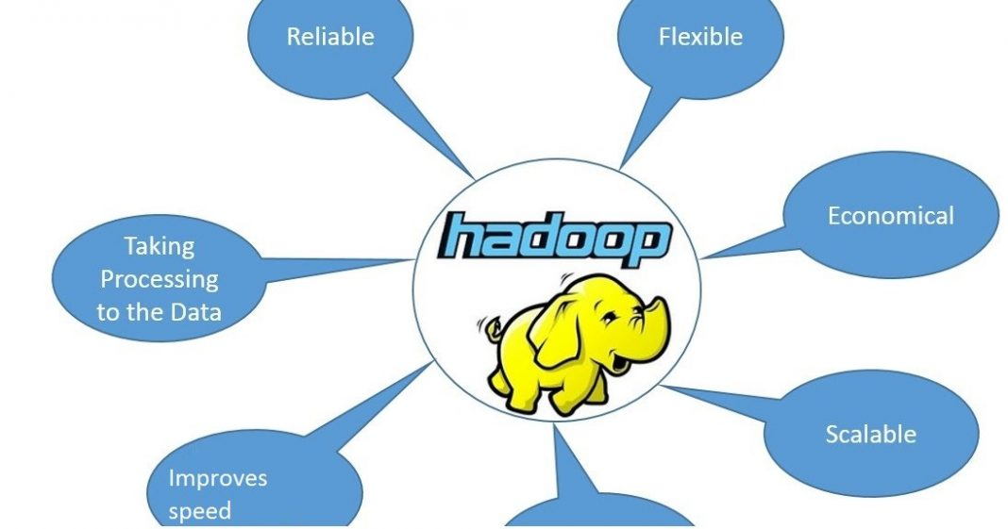
HADOOP
Hadoop is an open source framework from Apache and is used to store process and analyze data which are very huge in volume. Hadoop is written in Java and is not OLAP (online analytical processing). It is used for batch/offline processing.
The Hadoop Distributed File System (HDFS) is a distributed file system for Hadoop. It contains a master/slave architecture. This architecture consist of a single NameNode performs the role of master, and multiple DataNodes performs the role of a slave.
Both NameNode and DataNode are capable enough to run on commodity machines. The Java language is used to develop HDFS. So any machine that supports Java language can easily run the NameNode and DataNode software.

Slide 26
WHAT IS CLOUD COMPUTING?
IAAS
PAAS
IaaS, or Infrastructure as a Service, is a cloud computing model that provides on-demand access to computing resources such as servers, storage, networking, and virtualization.
PaaS is a cloud-based computing model that allows development teams to build, test, deploy, and scale applications faster and more cost-effectively.
SAAS
Simply put, cloud computing is the delivery of computing services—including servers, storage, databases, networking, software, analytics, and intelligence—over the Internet (“the cloud”) to offer faster innovation, flexible resources, and economies of scale.
Software as a service Software as a service (SaaS) allows users to connect to and use cloud-based apps over the Internet. Common examples are email, calendaring, and office tools

Slide 27
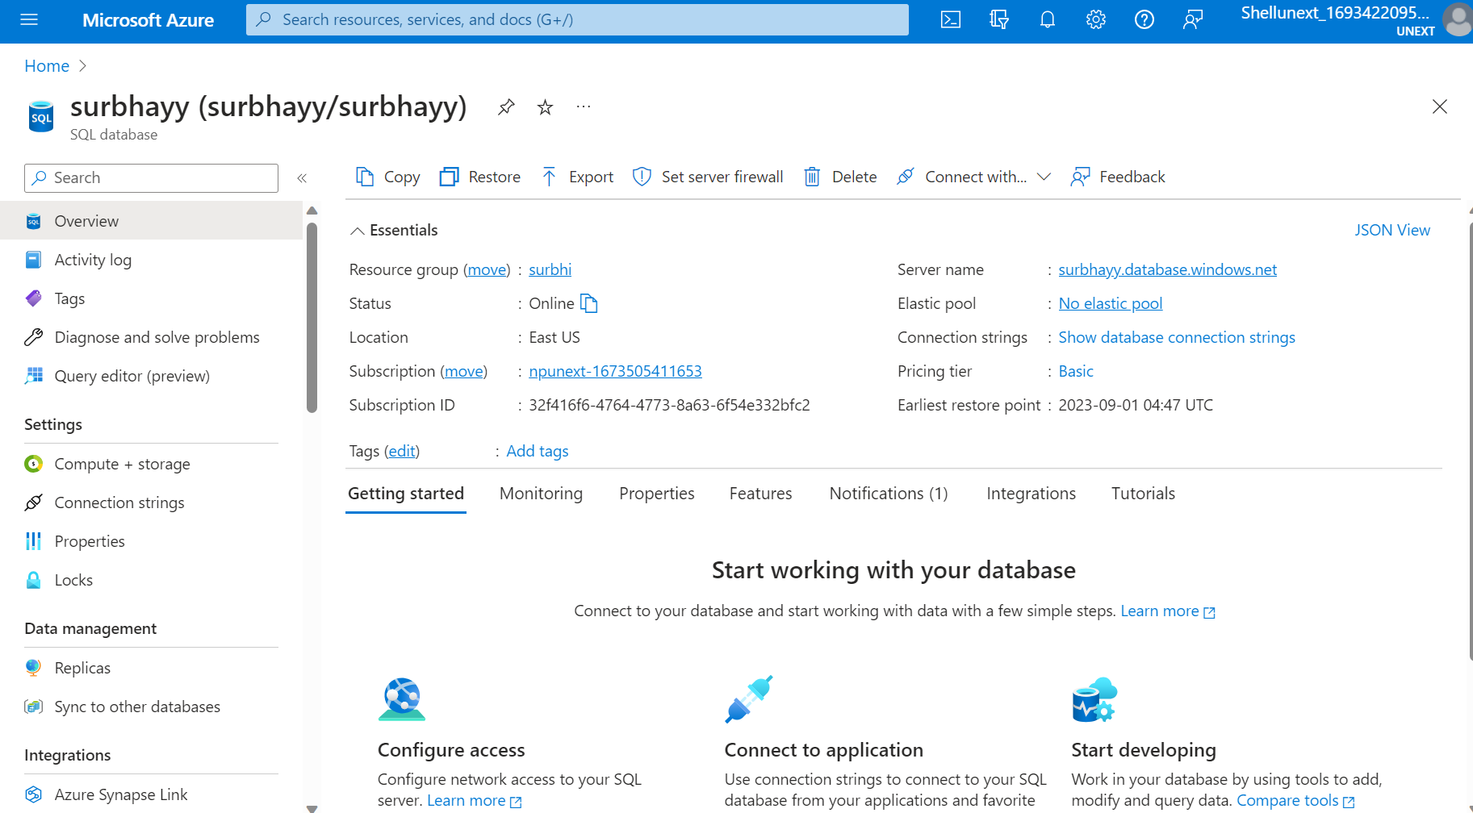
CREATE A SQL DAQTABASE RESOURCE ON AZURE

Slide 28
AZURE PLATFORM
Account
An account that's used to access and manage an Azure subscription. It's often referred to as an Azure account although an account can be any of these: an existing work, school, or personal Microsoft account.
Region
An area within a geo that does not cross national/regional borders and contains one or more datacenters. Pricing, regional services, and offer types are exposed at the region level.
Resource group
A container in Resource Manager that holds related resources for an application. The resource group can include all of the resources for an application, or only those resources that are logically grouped together. You can decide how you want to allocate resources to resource groups based on what makes the most sense for your organization.
Storage account
An account that gives you access to the Azure Blob, Queue, Table, and File services in Azure Storage. The storage account name defines the unique namespace for Azure Storage data objects.
Virtual machine
The software implementation of a physical computer that runs an operating system. Multiple virtual machines can run simultaneously on the same hardware. In Azure, virtual machines are available in a variety of sizes.
Azure Data Lake
Analytics is an on-demand analytics job service that simplifies big data. Instead of deploying, configuring, and tuning hardware, you write queries to transform your data and extract valuable insights. The analytics service can handle jobs of any scale instantly by setting the dial for how much power you need. You only pay for your job when it's running, making it cost-effective.

Slide 29
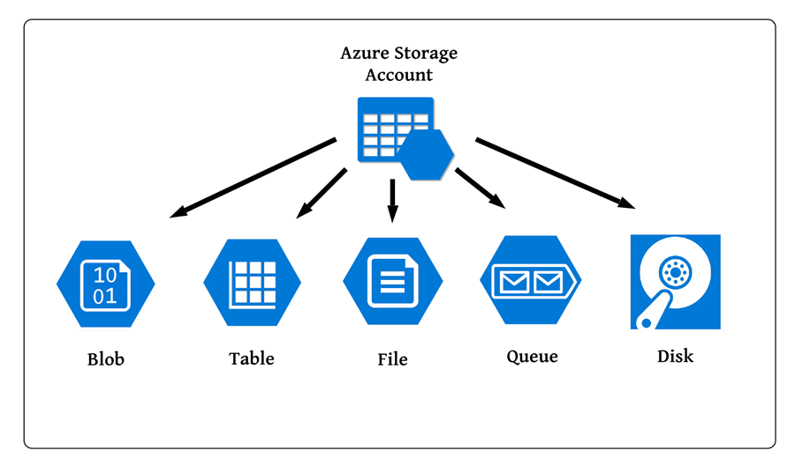
TYPES OF AZURE STORAGE

Slide 30
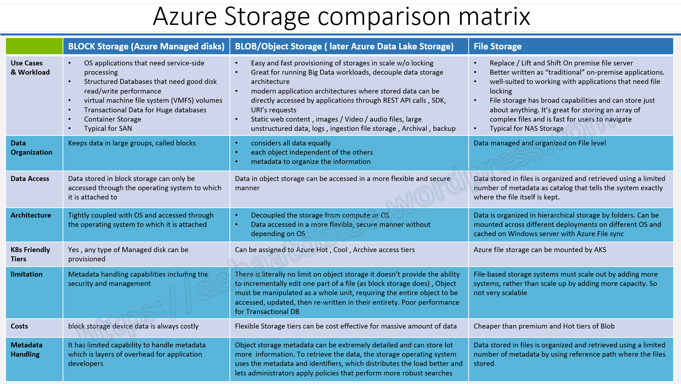

Slide 31
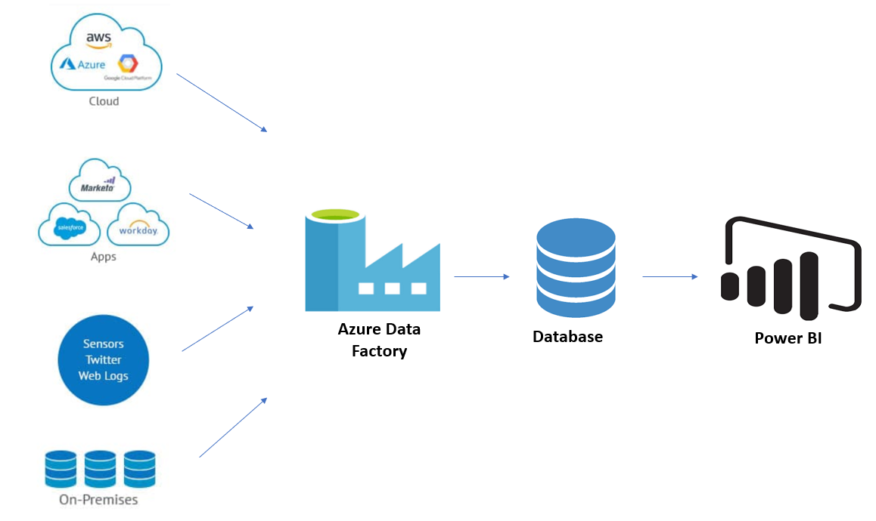
Pipeline
A data factory might have one or more pipelines. A pipeline is a logical grouping of activities that performs a unit of work. Together, the activities in a pipeline perform a task. For example, a pipeline can contain a group of activities that ingests data from an Azure blob, and then runs a Hive query on an HDInsight cluster to partition the data.
Mapping data flows
Create and manage graphs of data transformation logic that you can use to transform any-sized data. You can build-up a reusable library of data transformation routines and execute those processes in a scaled-out manner from your ADF pipelines. Data Factory will execute your logic on a Spark cluster that spins-up and spins-down when you need it. You won't ever have to manage or maintain clusters.
Activity
Activities represent a processing step in a pipeline. For example, you might use a copy activity to copy data from one data store to another data store. Similarly, you might use a Hive activity, which runs a Hive query on an Azure HDInsight cluster, to transform or analyze your data. Data Factory supports three types of activities: data movement activities, data transformation activities, and control activities.
Datasets
Datasets represent data structures within the data stores, which simply point to or reference the data you want to use in your activities as inputs or outputs.
Linked services
Linked services are much like connection strings, which define the connection information that's needed for Data Factory to connect to external resources. Think of it this way: a linked service defines the connection to the data source, and a dataset represents the structure of the data

Slide 32
Triggers
Triggers represent the unit of processing that determines when a pipeline execution needs to be kicked off. There are different types of triggers for different types of events.
Pipeline runs
A pipeline run is an instance of the pipeline execution. Pipeline runs are typically instantiated by passing the arguments to the parameters that are defined in pipelines. The arguments can be passed manually or within the trigger definition.
Parameters
Parameters are key-value pairs of read-only configuration. Parameters are defined in the pipeline. The arguments for the defined parameters are passed during execution from the run context that was created by a trigger or a pipeline that was executed manually. Activities within the pipeline consume the parameter values.
A dataset is a strongly typed parameter and a reusable/referenceable entity. An activity can reference datasets and can consume the properties that are defined in the dataset definition.
A linked service is also a strongly typed parameter that contains the connection information to either a data store or a compute environment. It is also a reusable/referenceable entity.
Control flow
Control flow is an orchestration of pipeline activities that includes chaining activities in a sequence, branching, defining parameters at the pipeline level, and passing arguments while invoking the pipeline on-demand or from a trigger. It also includes custom-state passing and looping containers, that is, For-each iterators.
Variables
Variables can be used inside of pipelines to store temporary values and can also be used in conjunction with parameters to enable passing values between pipelines, data flows, and other activities.

Slide 33
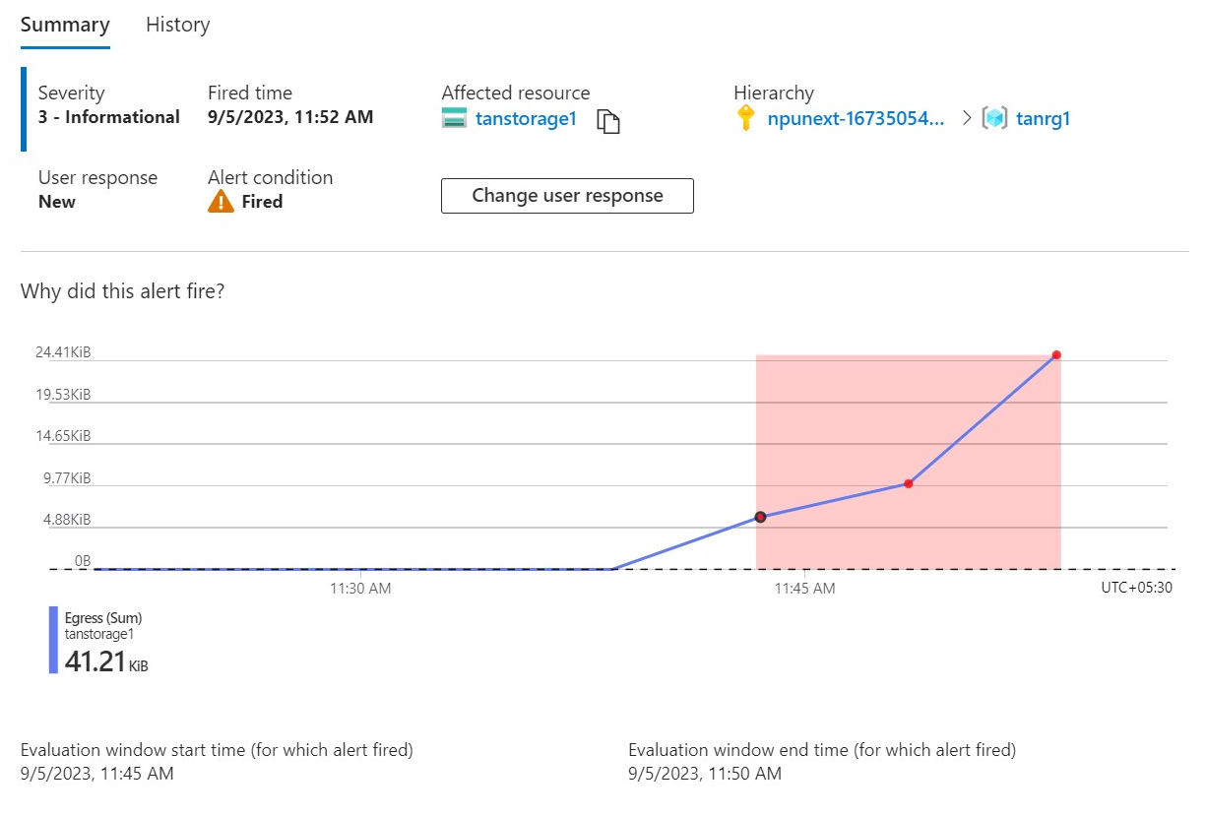
CREATING ALERTS

Slide 34
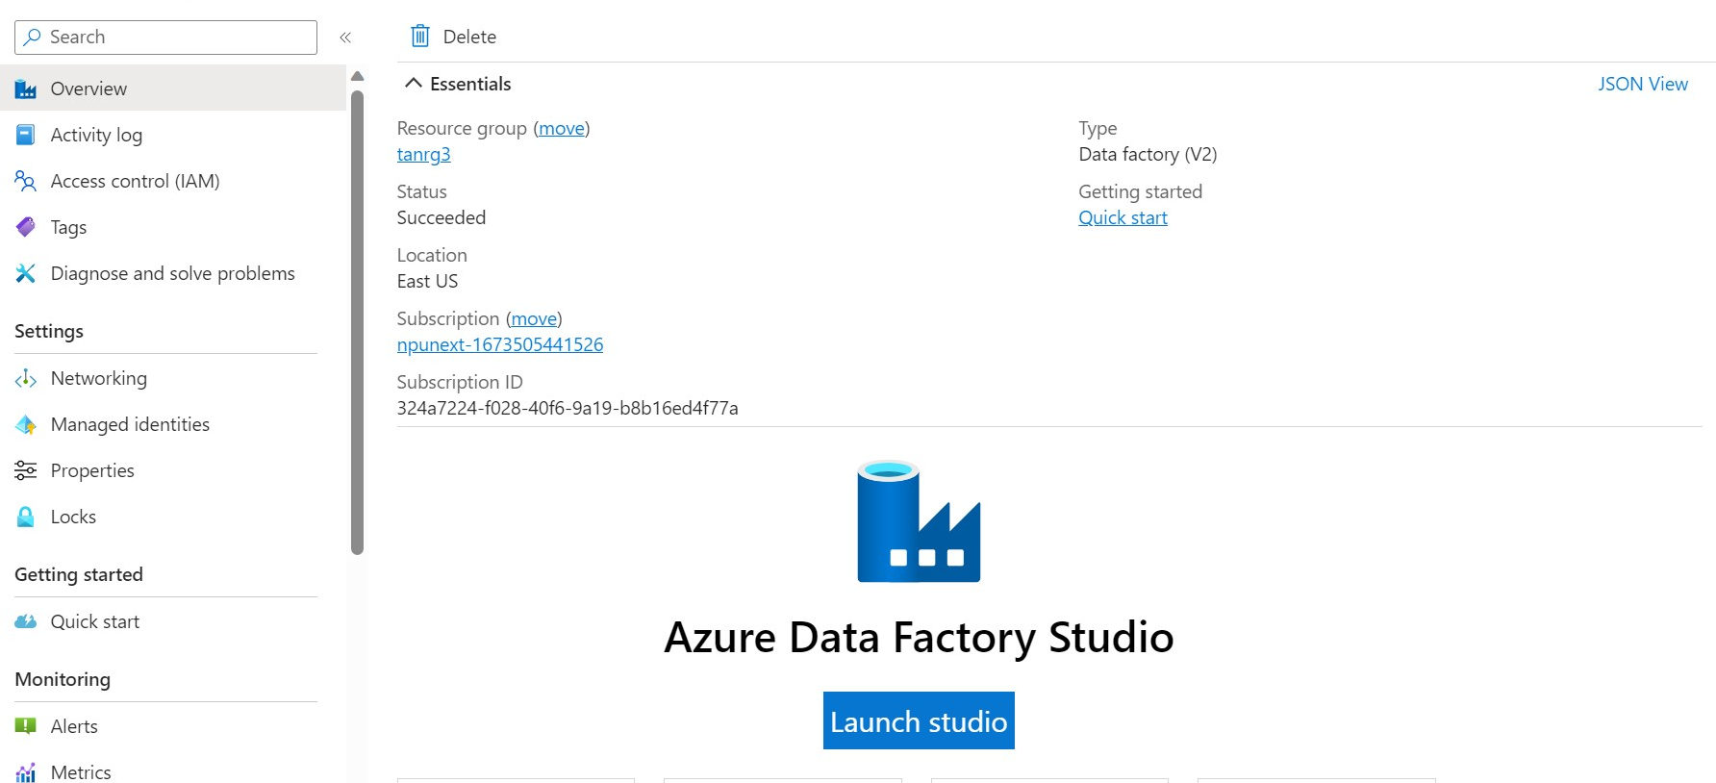
AZURE DATA FACTORY

Slide 35
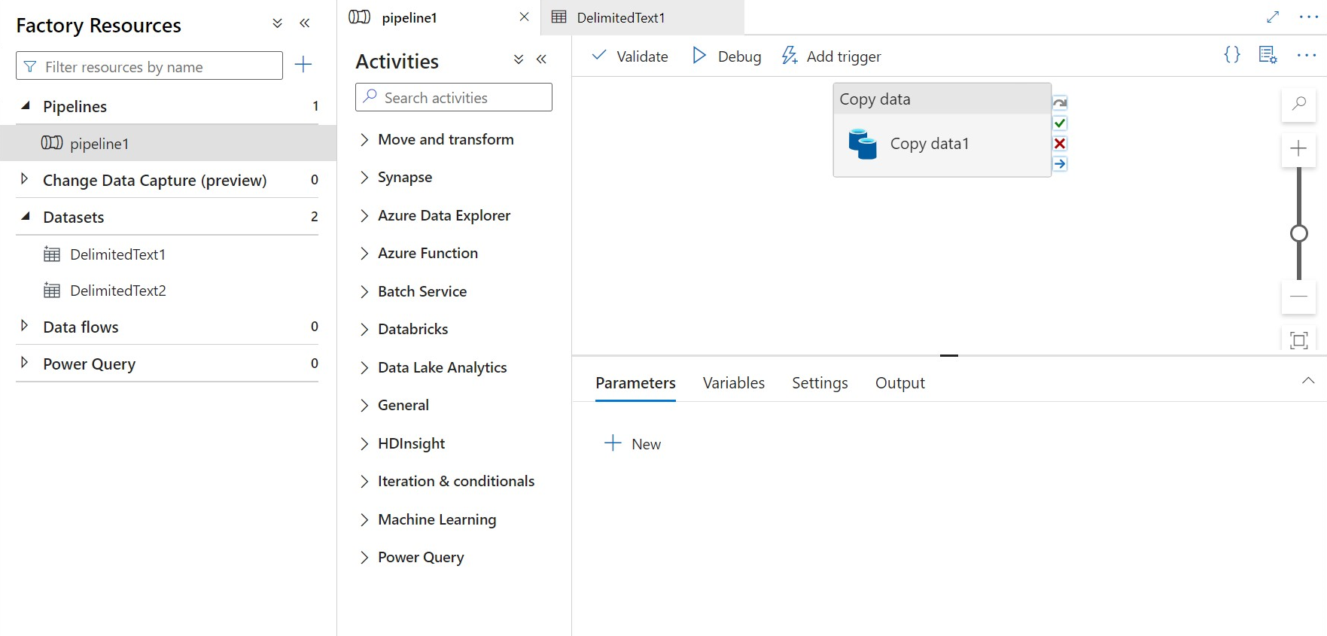
CREATING DATA PIPELINE

Slide 36
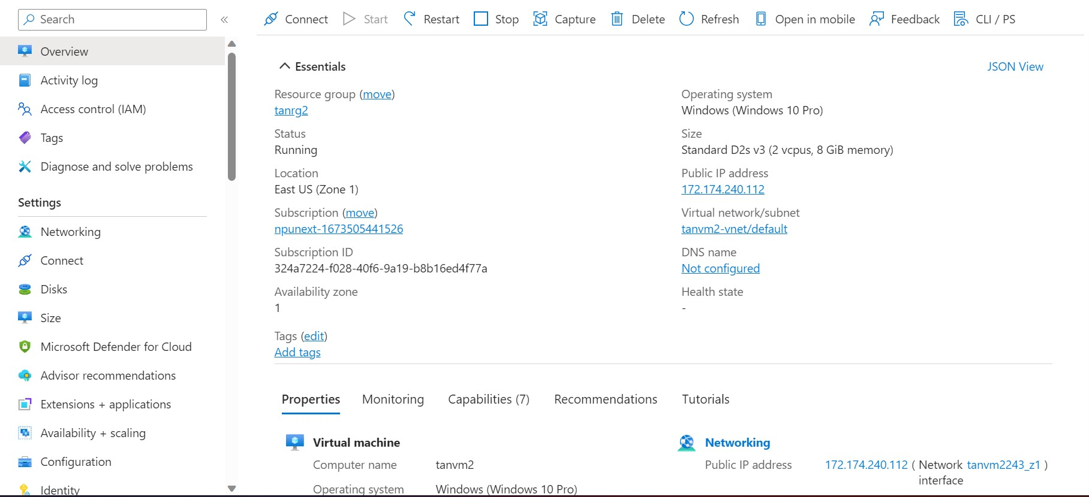
CREATING VIRTUAL MACHINES

Slide 37
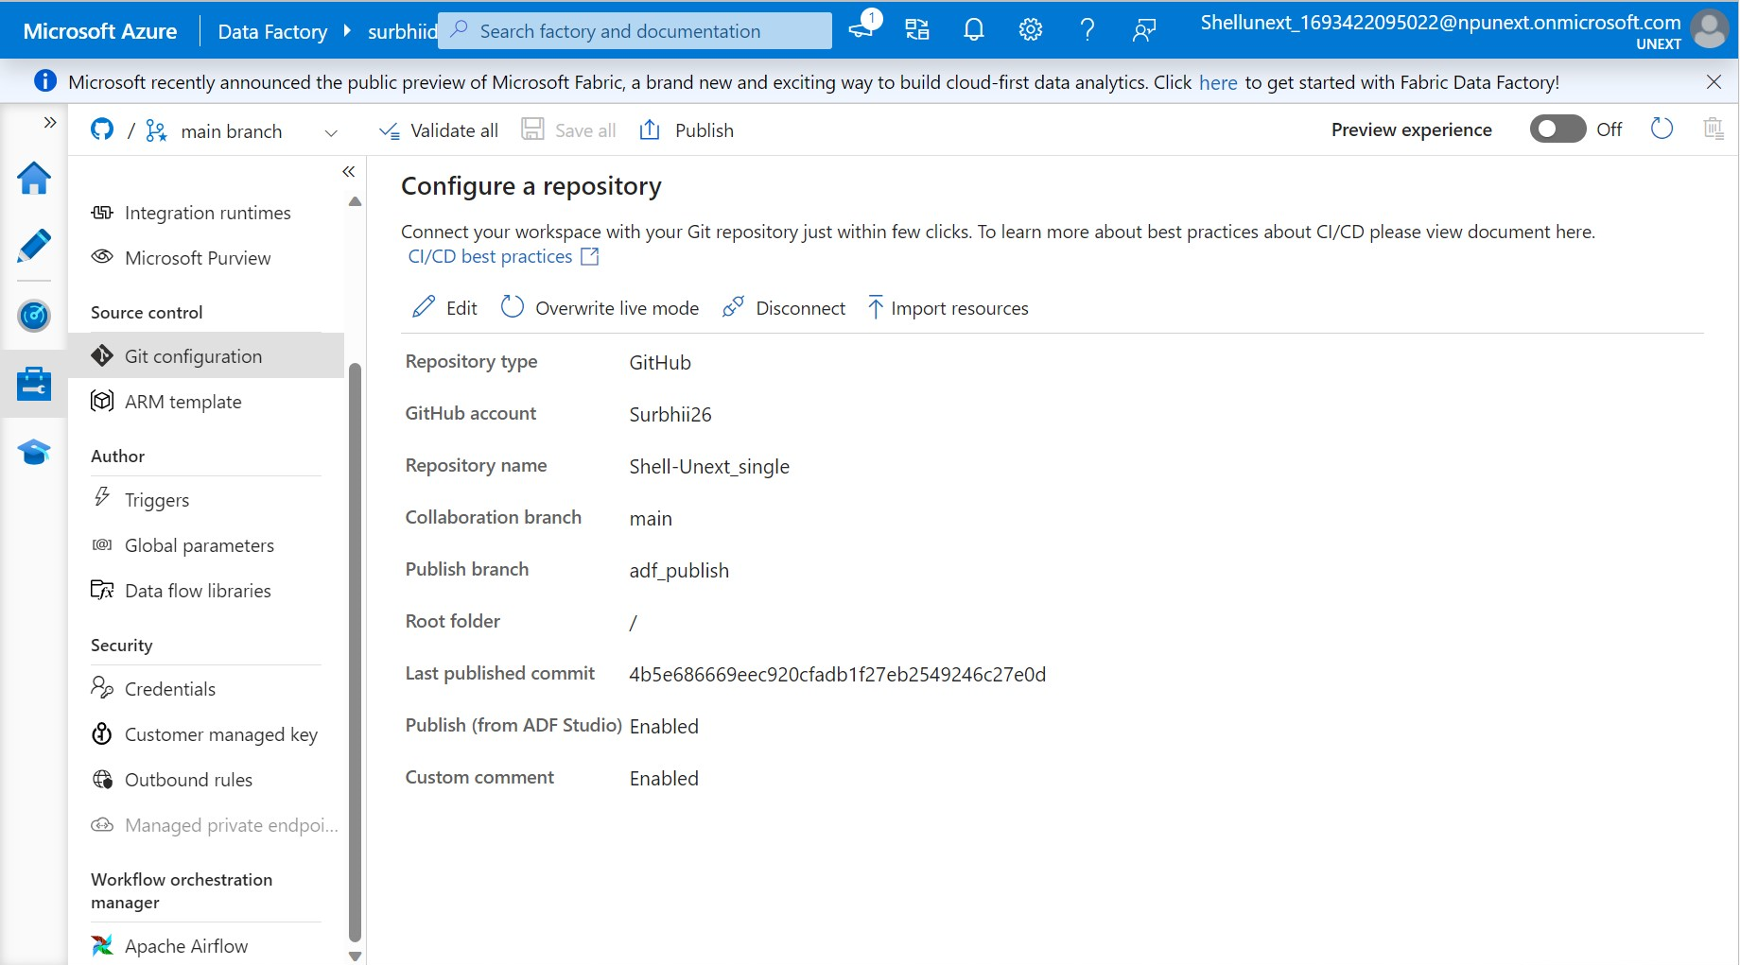
CONFIGURING GITHUB

Slide 38
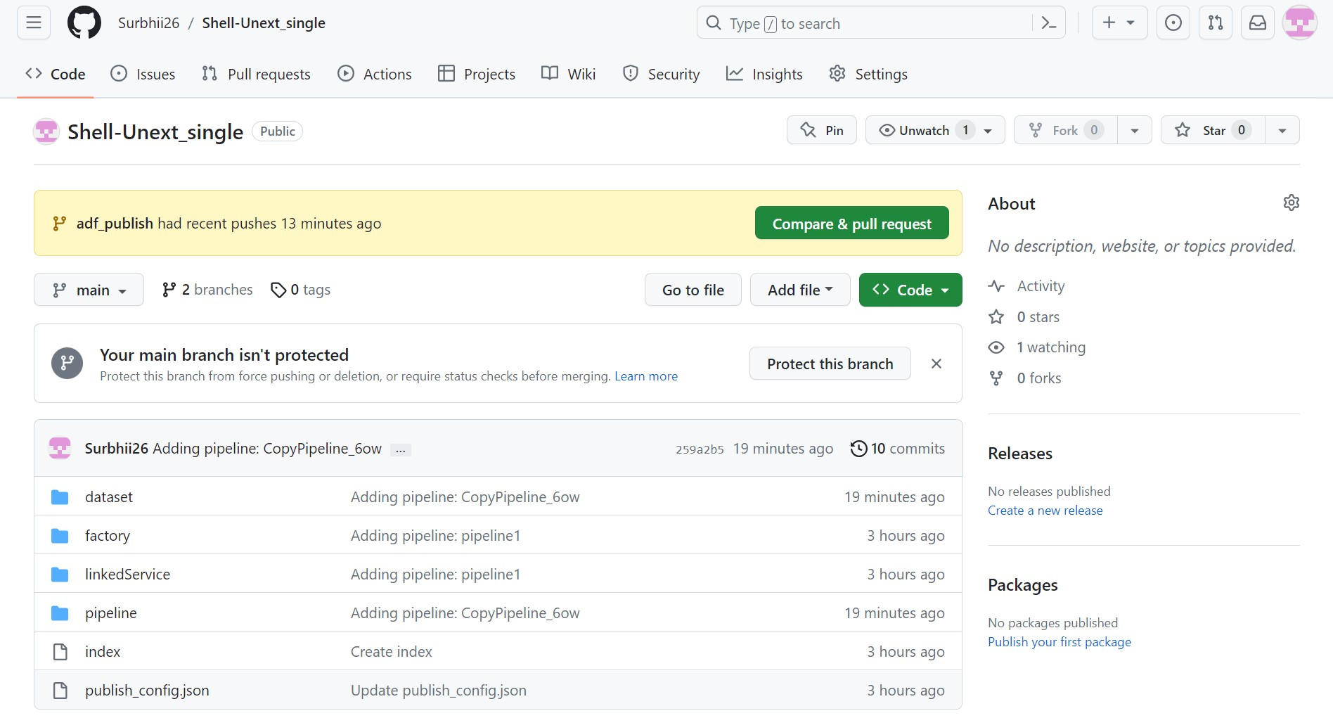
CONFIGURING GITHUB

Slide 39
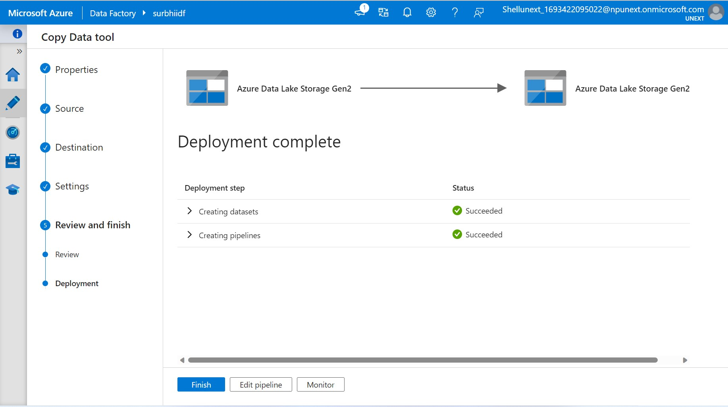
CREATING PIPELINE

Slide 40
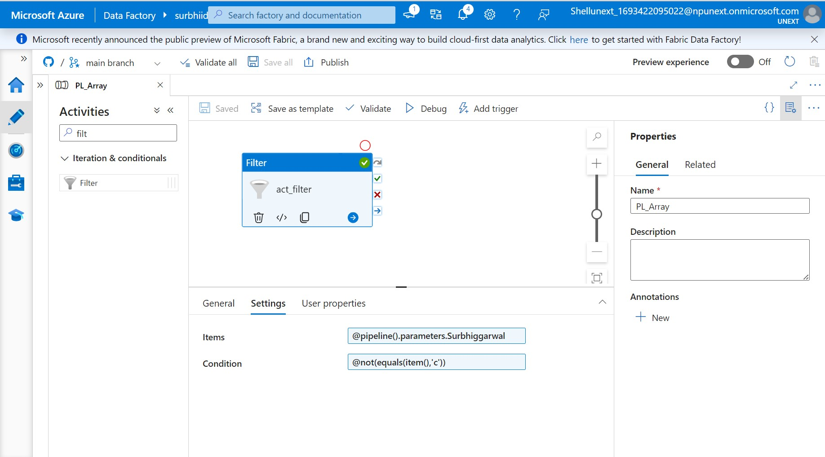
CREATING FILTERS

Slide 41
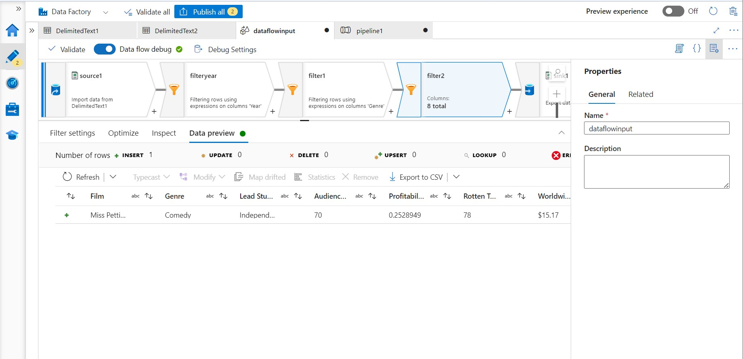
CREATING FILTERS

Slide 42
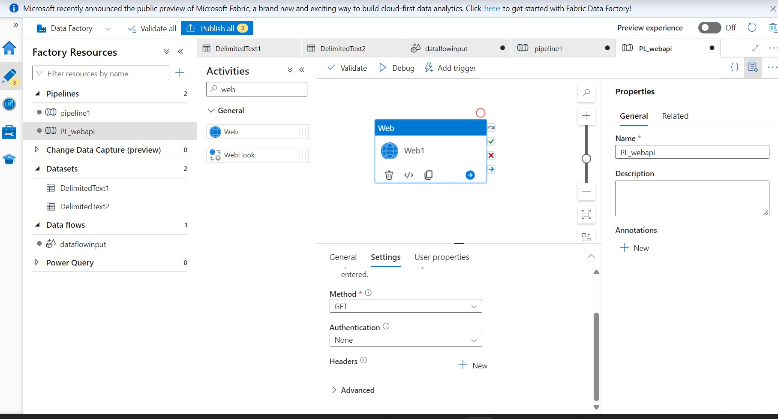
WORKING ON WEB

Slide 43
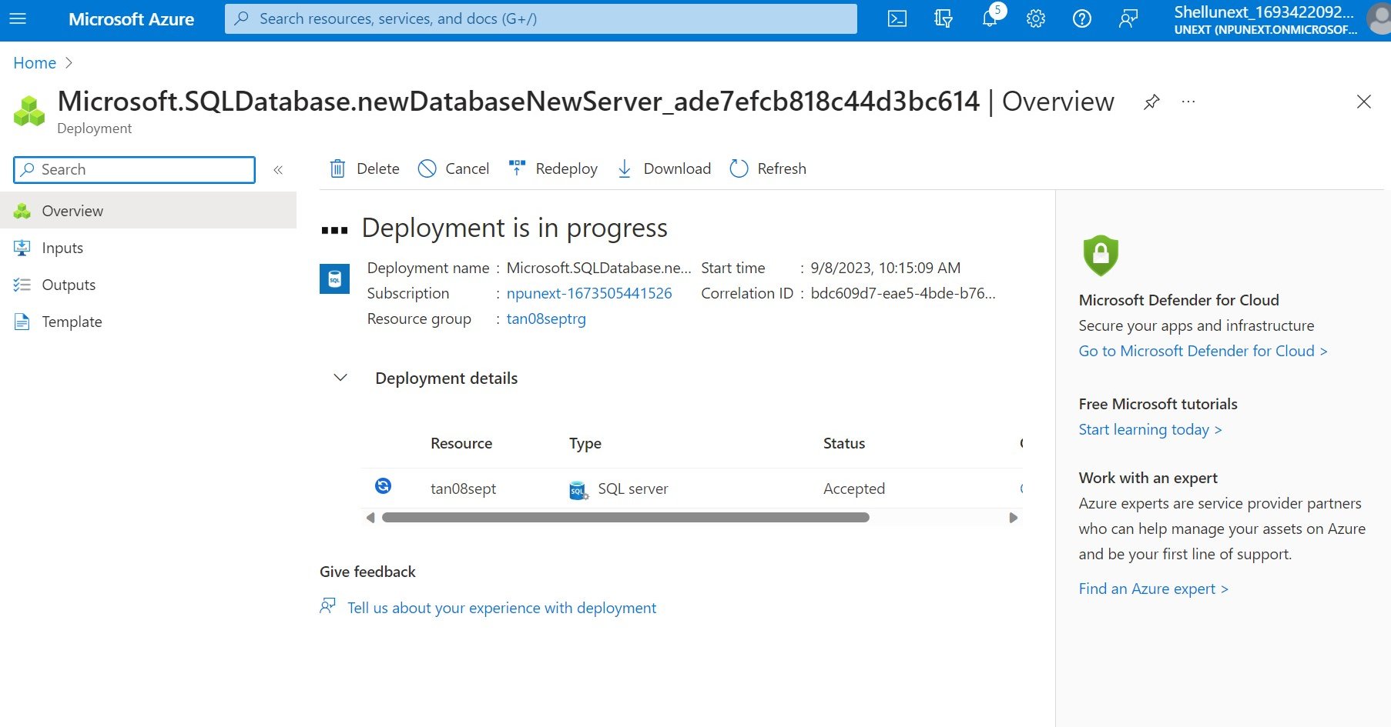
CONNECTED SQL DATABSE

Slide 44
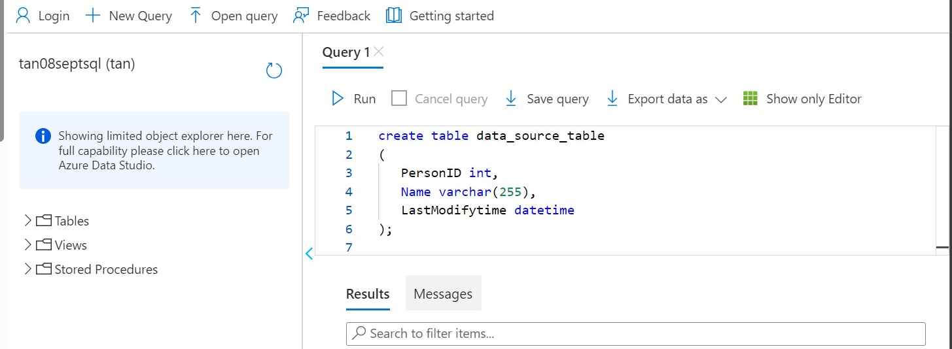
QUERY EDITOR

Slide 45
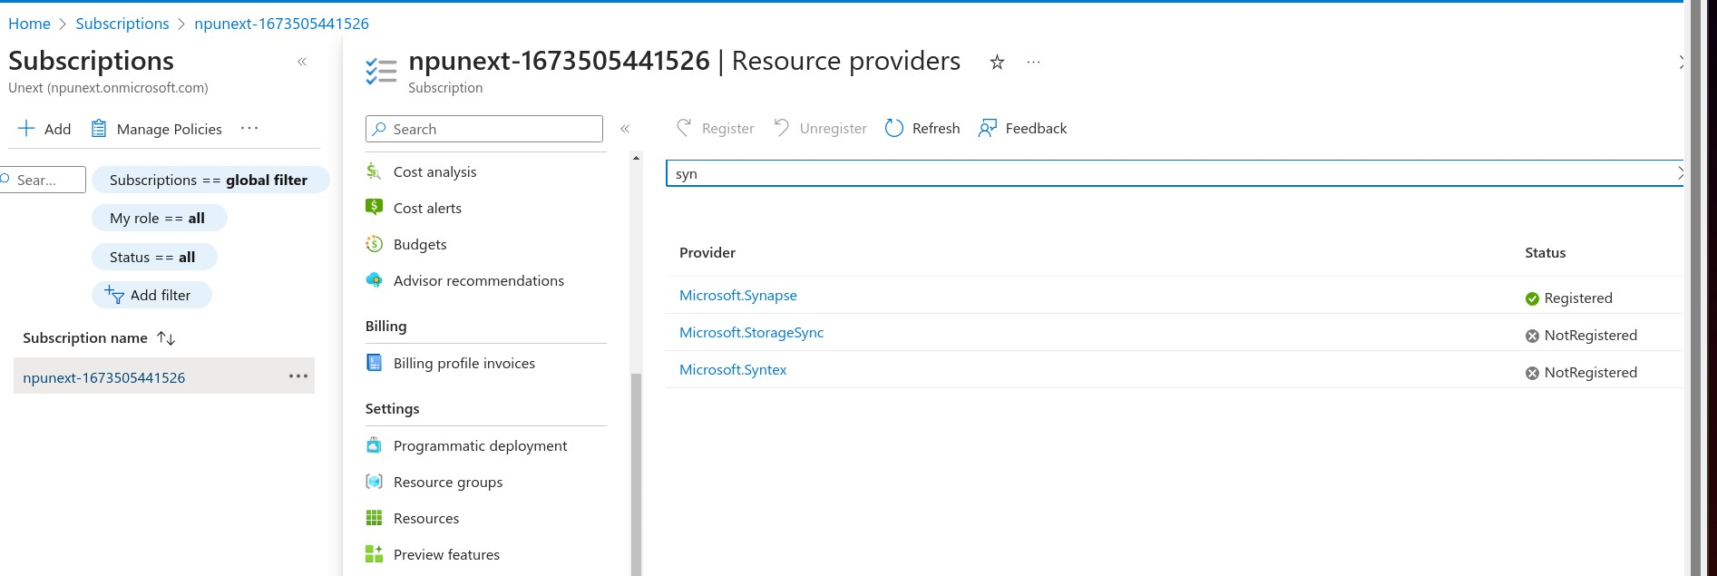
Introduction to Azure Synapse Analytics
Large scale Data warehousing
Advanced Analytics
Real time Analytics
Data Integration

Slide 46
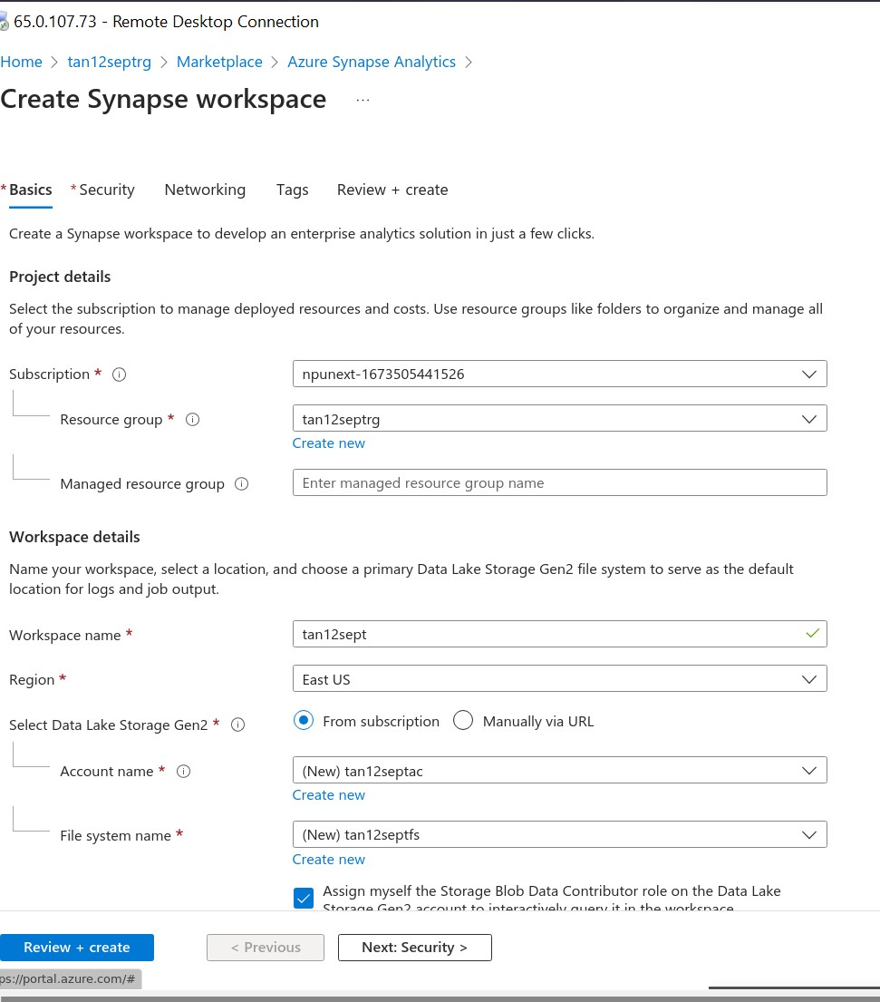
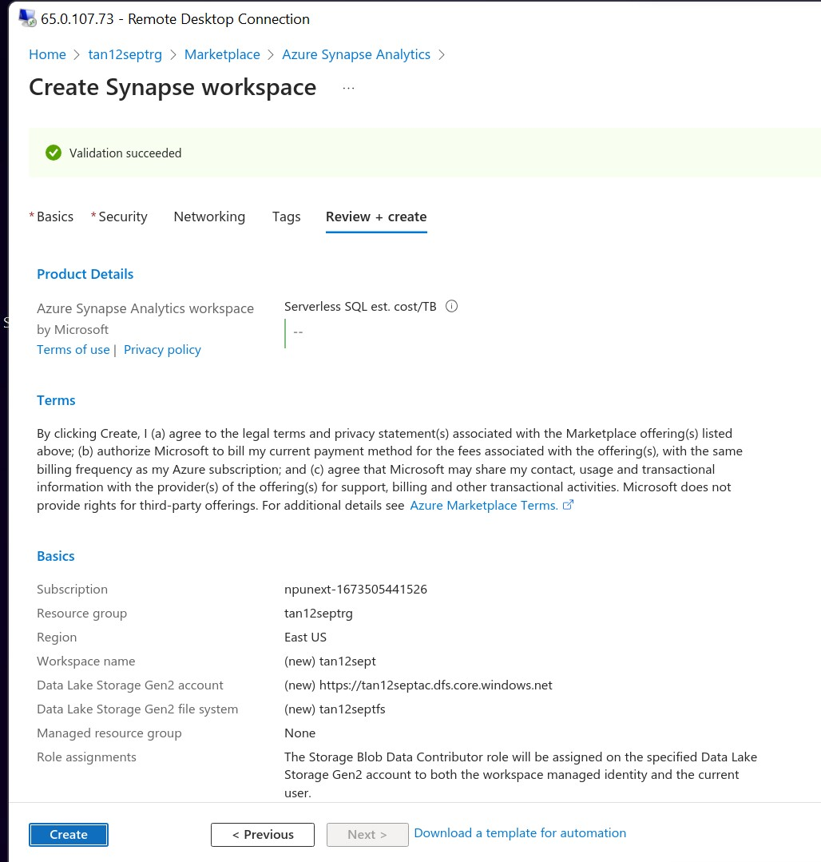
Azure Synapse Analytics

Slide 47
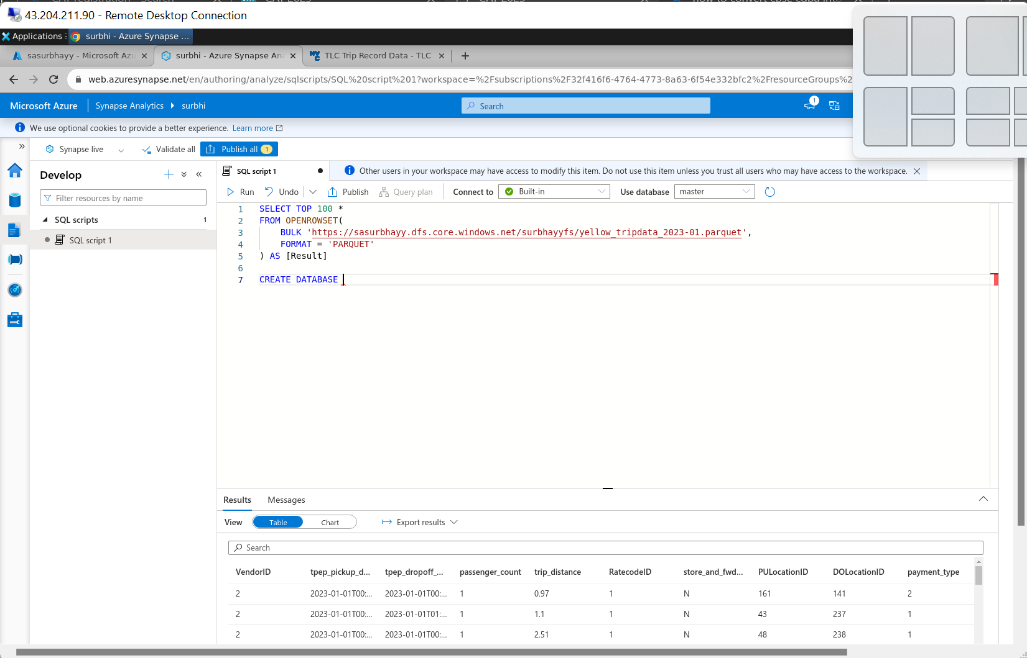
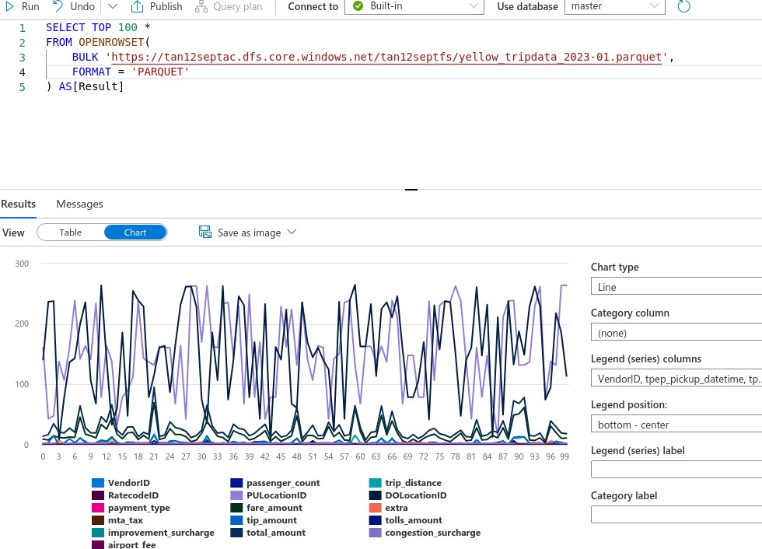
Azure Synapse Analytics

Slide 48
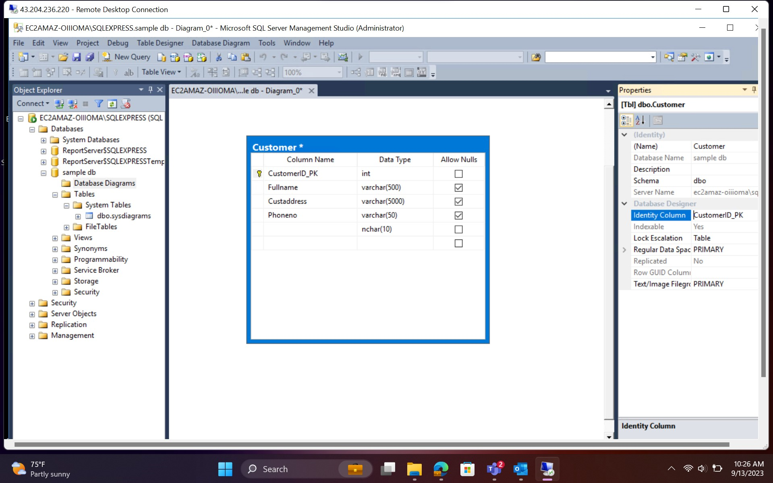
DATABASE DIAGRAMS

Slide 49
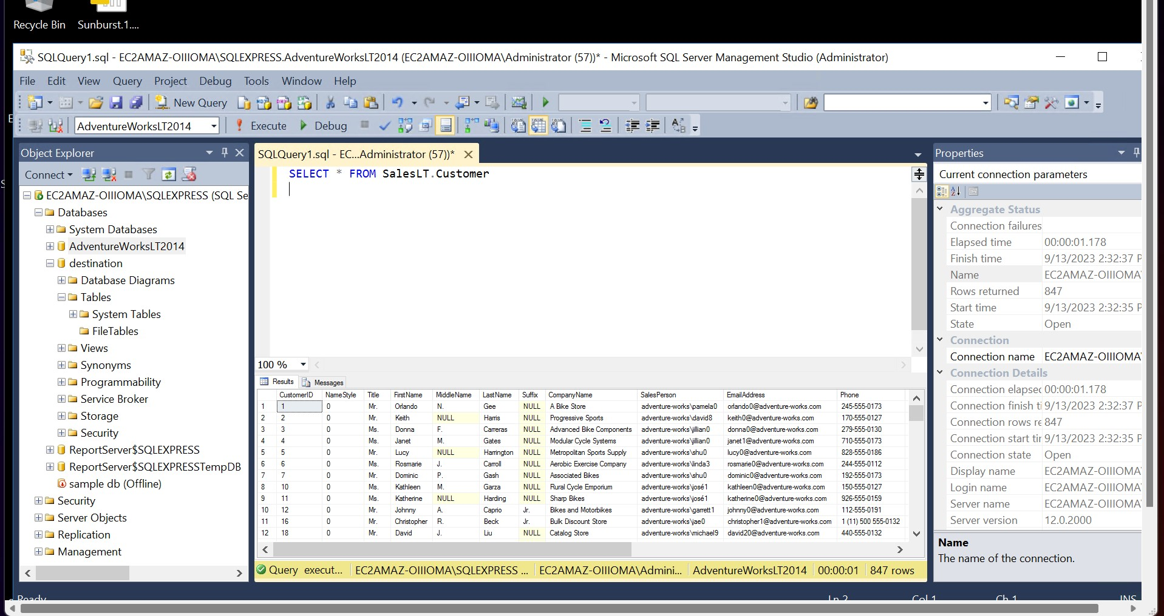
USING SQL SERVER TO LOAD DATA IN BI DASHBOARD

Slide 50
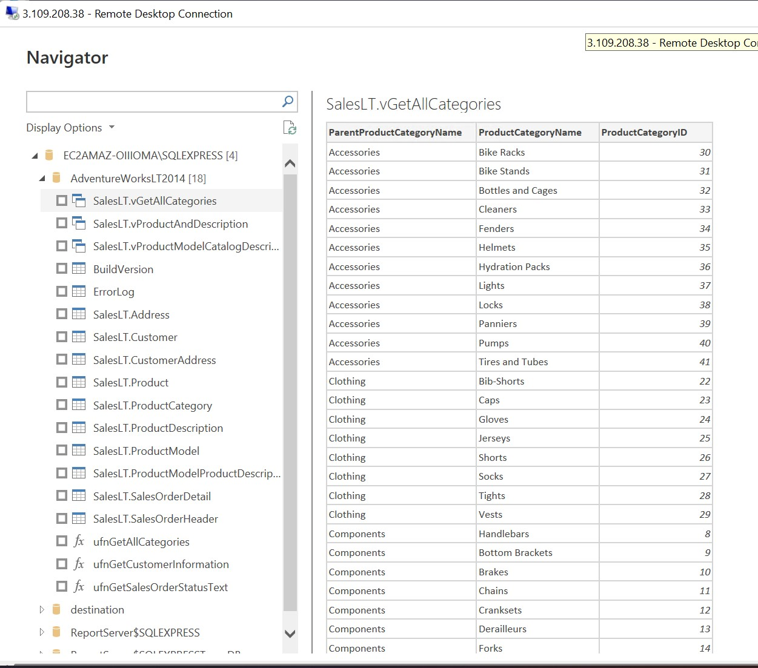
USING SQL SERVER TO LOAD DATA IN BI DASHBOARD

Slide 51
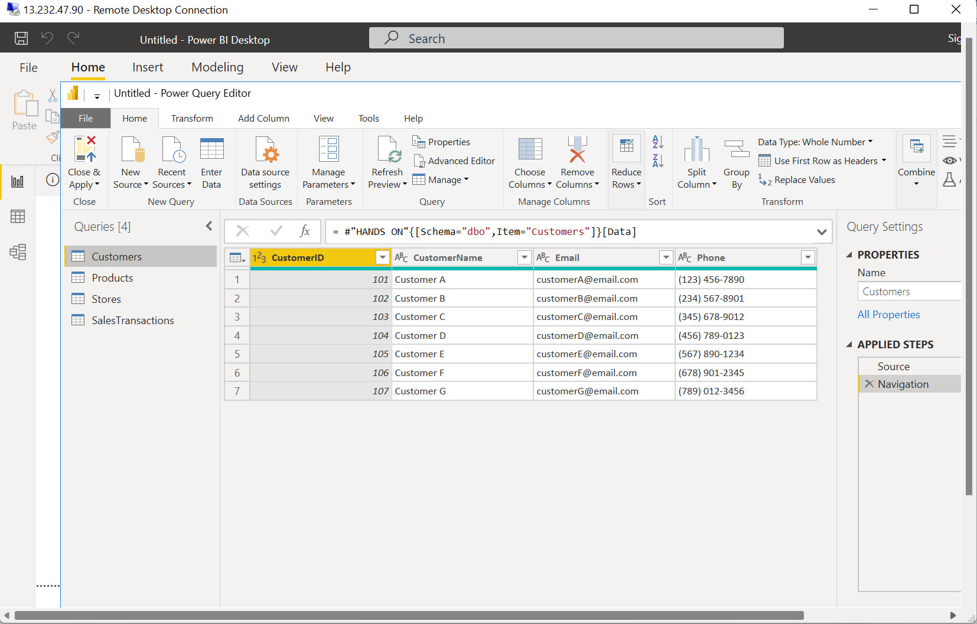
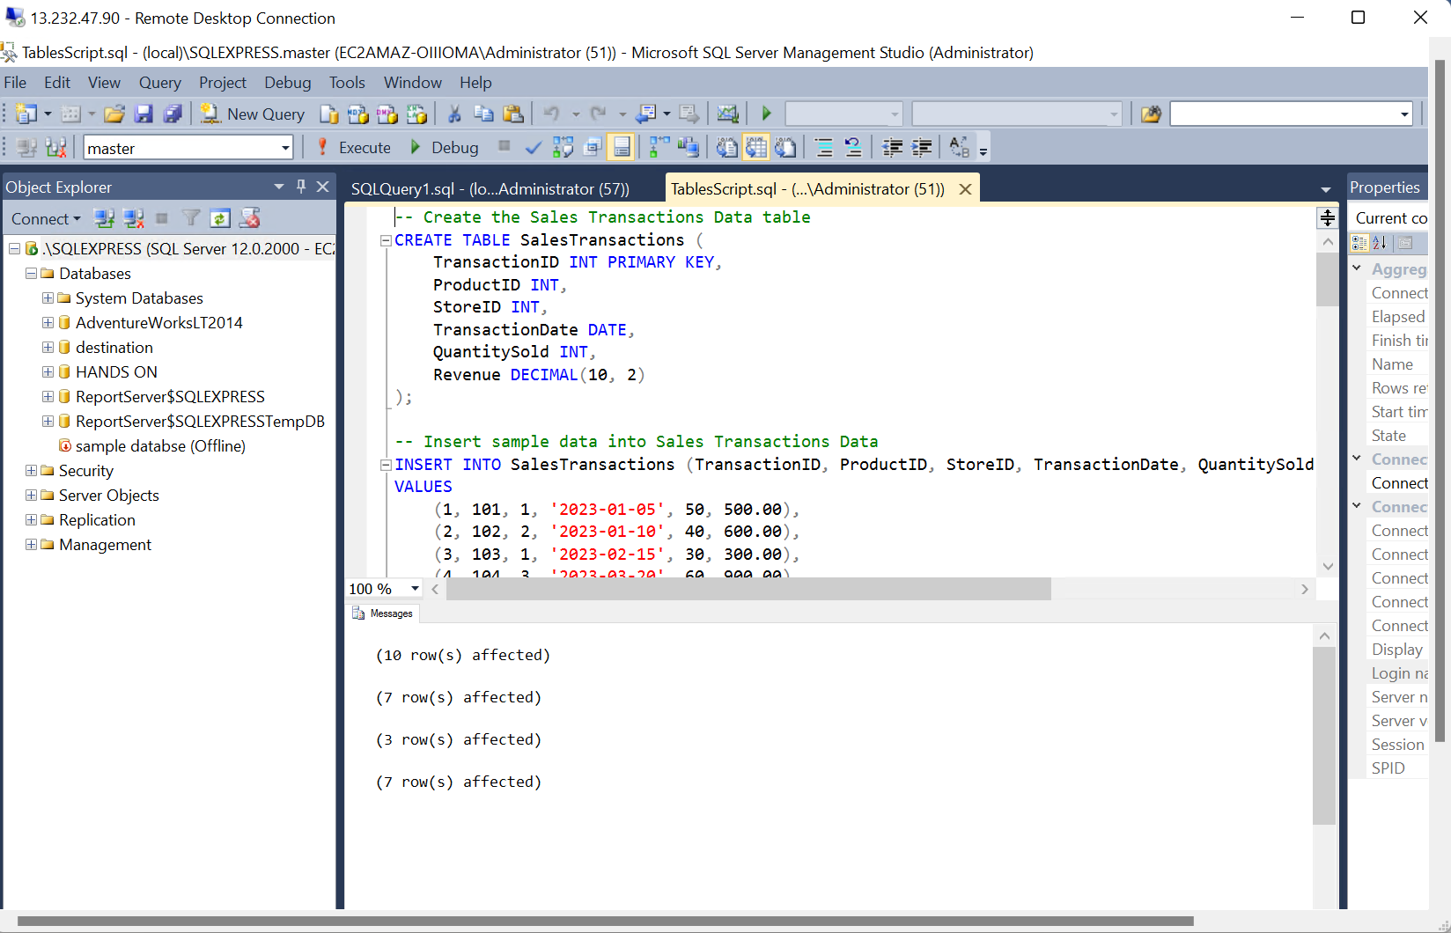
CASE – STUDY
Scenario: Sales Performance Analysis with Power BI In this scenario, let's imagine you work for a retail company and you've been tasked with analyzing the sales performance of your products and stores using Power BI. You have multiple data sources and tables to work with, and your goal is to provide actionable insights to improve sales strategies

Slide 52
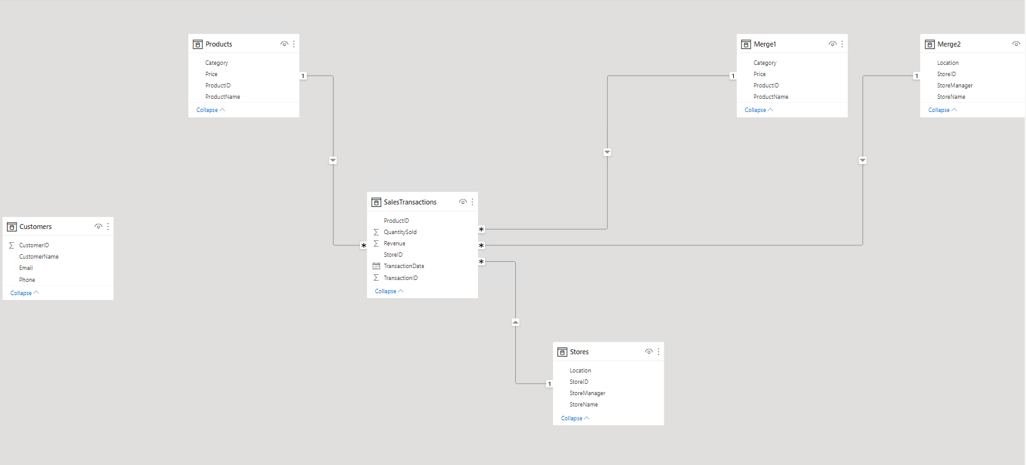
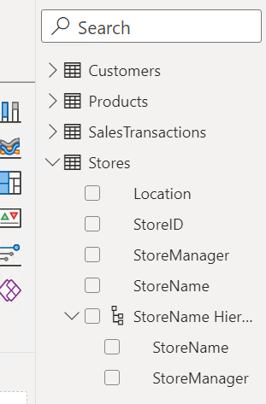
CASE – STUDY DATA MODEL AND HIERARCHY

Slide 53




CASE – STUDY VISUALIZATIONS

Slide 54

PYTHON
Python has an easy-to-read syntax, making it easy to write and understand code. Its use of keywords and indentation helps maintain code structure.
Python is cross-platform, allowing code to run on various operating systems without modification.
Python is a high-level programming language, which means that it abstracts low-level details, making coding easier for developers.

Slide 55


DATA STRUCTURES IN PYTHON

Slide 56
KEY – VALUE PAIRS

Slide 57

PYSPARK
PySpark is a powerful open-source framework for distributed data processing and analysis, particularly well-suited for big data applications.

Slide 58

RDD (RESILIENT DISTRIBUTED DATASET)

Slide 59


HANDS –ON

Slide 60


HANDS –ON

Slide 61


HANDS –ON

Slide 62

HANDS –ON

